Slide 1
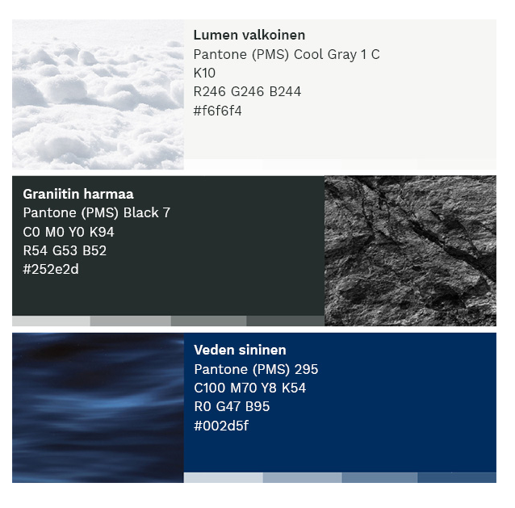
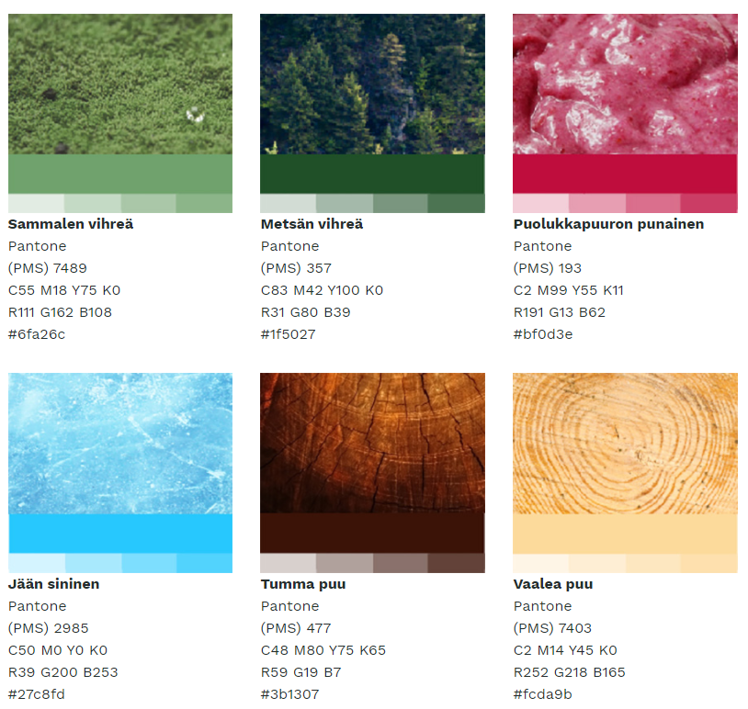
#f6f6f4
#f7f7f6
#f9f9f8
#fbfbfa
#fdfdfc
#252e2d
#505757
#7c8181
#a7abab
#d3d5d5
#002c5f
#33567f
#66809f
#99aabf
#ccd4df
#6fa26c
#8bb489
#a8c7a6
#c5d9c4
#e2ece1
#1f5027
#4b7352
#78967d
#a5b9a8
#d2dcd3
#bf0d3f
#cb3d65
#d86d8b
#e59eb2
#f2ced8
#27c7fd
#52d2fd
#7dddfd
#a8e8fe
#d3f3fe
#3b1307
#624238
#89716a
#b0a09b
#d7cfcd
#fcda9b
#fce1af
#fde8c3
#fdf0d7
#fef7eb

